Slide 1
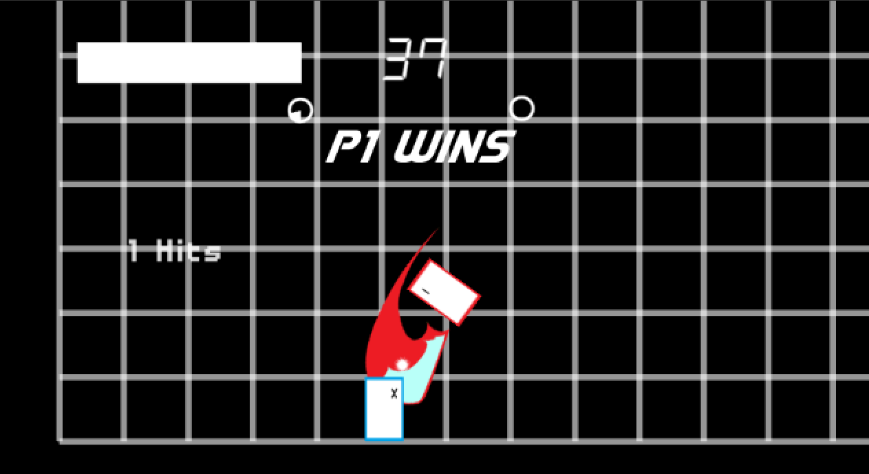
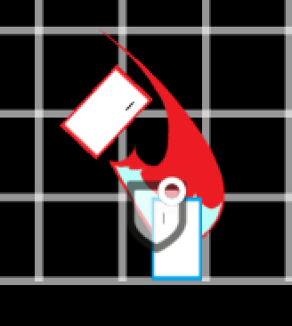
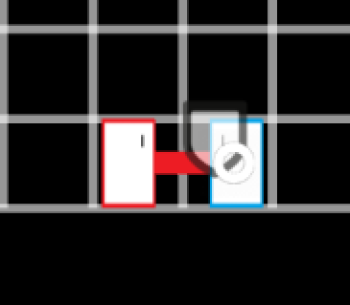
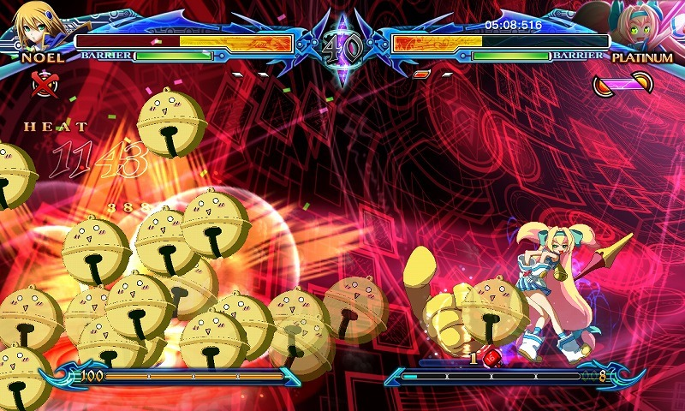
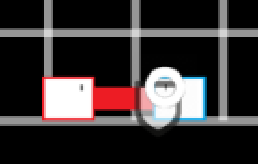
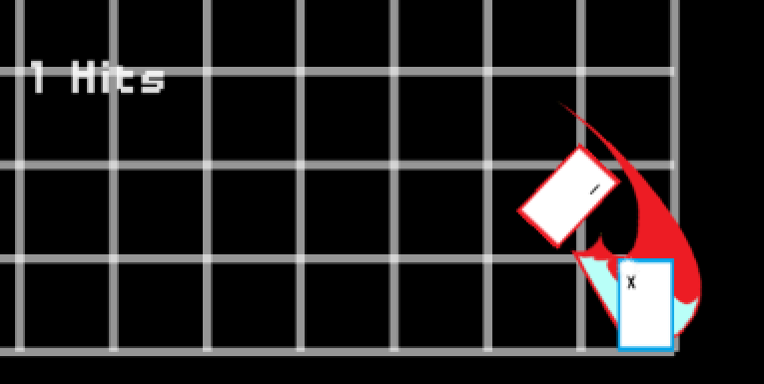
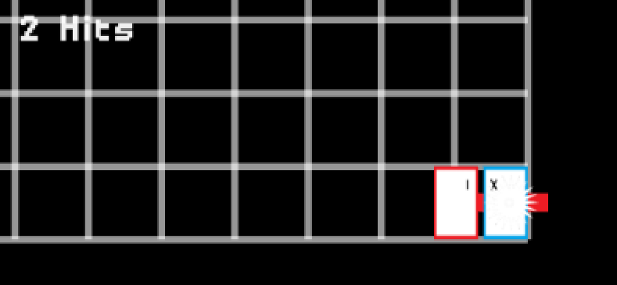
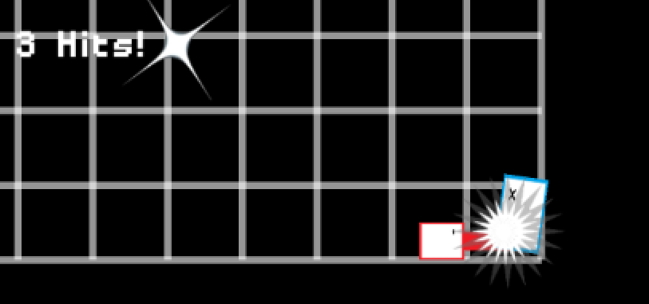
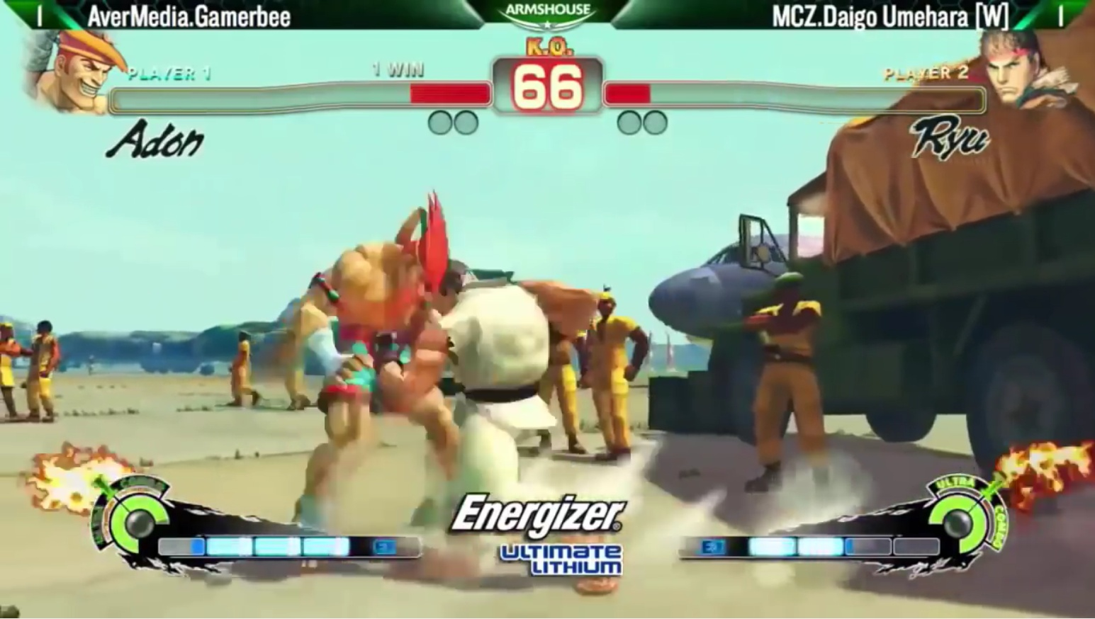
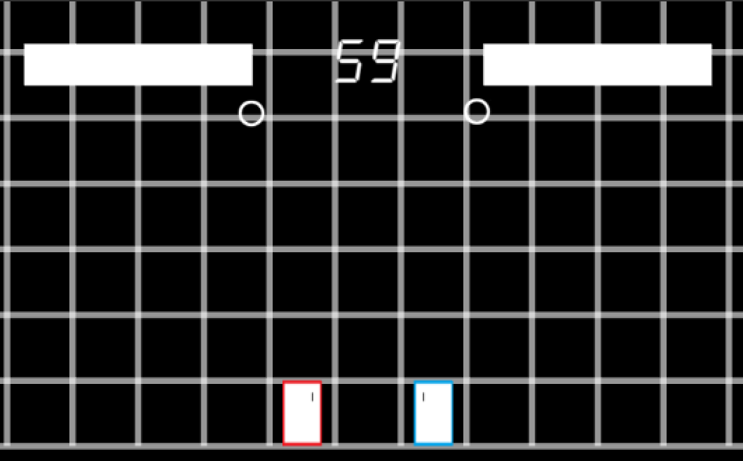
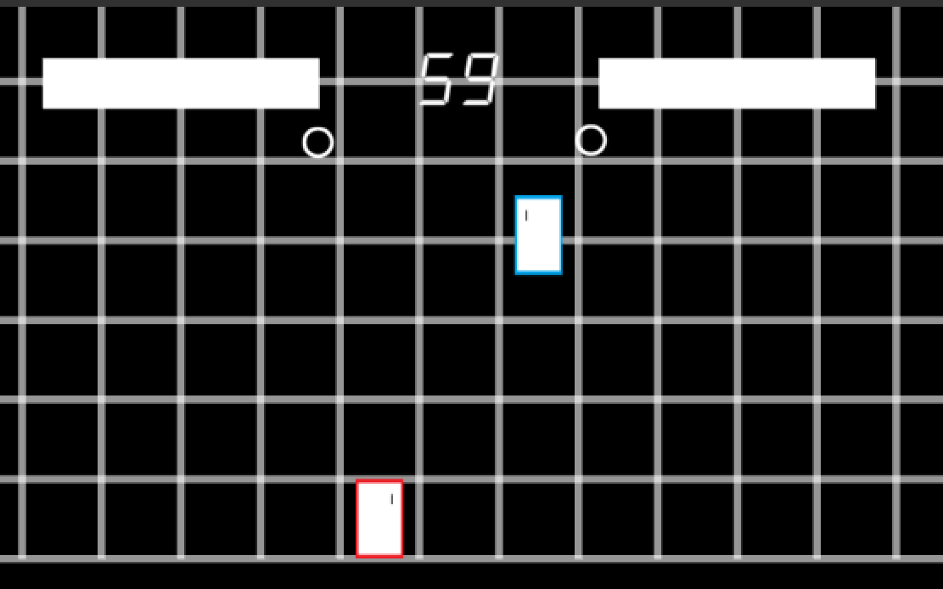
Learning Player Playstyles with Artificial Intelligence
Roger Liu
Carnegie Mellon University, School of Computer Science
Overview
What is a Fighting Game?
Collected Data
Among the types of competitive games that are played, fighting games are unique in that they are real-time, 1-on-1 games with little room for error. The best way to get better at these kinds of games is to practice against other humans, but that is not always an option. While online play exists, is not ideal because of network latency. The artificial intelligence in the games also perform poorly unless they exploit their perfect reaction times, perfect execution, and ability to read the user’s input.
In these kinds of games, two players face off in an area with the objective of reducing their opponents health to 0 first. This determines the winner of a round. Each the winner of a game is usually determined by a best of 3 rounds.
Player can perform a variety of attacks which have situational uses. Because players can block attacks if they defend correctly, part of the strategy is determining when and where to use moves. In the simplest game, you have to block attacks high or low.
Field Name | Description
actionTaken | (enum) Describes how the player moved, if they jumped, if they attacked etc.
timeDelay | (float) Describes the time since the last snapshot was recorded
timeRemaining | (enum) Describes how much time is left. Players change their behavior depending on if there's a lot of time (60-15 seconds) or a little (< 15 seconds)
p1Health | (int) the health of player 1
p2Health | (int) the health of player 2
xDistance | (enum) How close are the players horizontally. Behavior changes if their Far or Close
yDistance | (enum) How close are the players vertically. Behavior changes if their Far or Close
p1CornerDistance | (enum) How close is player 1 to the corner. A cornered player is more restriced, so they behave differently
p2CornerDistance | (enum) How close is player 2 to the corner.
labels | (String[]) Additional information to classify a session. Currently houses the Offensive vs. Defensive Labels
Players have to be able to anticipate where the opponent will attack or block and strategize around it. In a sense, fighting games are like a cross between poker and speed chess
Lastly, fighting games have a combos where players where players are able to hit their opponent with a string of attacks that they can’t defend. Something that makes fighting games difficult is being able to recognize the opportunities for combos and to execute them correctly.
Current Artificial Intelligence are artificially difficult. Speaking quite frankly, they cheat
Objective
Conclusion/Future Work
The goal of this independent study was to create an AI which can convincingly simulate human behavior. Specifically we want our system able to figure out and implement the strategies of the player that it’s mimicking.
A 3 hit combo. If the opponent is closer to the corner, more combo opportunities are present
At the moment, the data is being collected for practical implementation of the approached AI framework.
Once a significant amount of usable practice data has been collected, we will start to create player specific models that we want the AI to learn.
Once we have a model, we will use it to have the AI balance between strictly following the behavior of past experiences and performing actions which will allow it to win the game
Methods and Approach
Data Collection:
Whenever the player or opponent takes an action, a snapshot of the situation is taken.
Snapshots are vectors that describe the current state of the game.
The snapshots taken throughout a round are compiled into a session, and written to a log
Classify Data
After a game is played, players can classify the type of play that their opponent did during the match.
This served as a baseline for the robustness of the system
Finding Patterns:
High level actions like a Jumping Attack requires that a player first does a Jump action followed by an Attack action
High level actions were found by going through the logs and finding sequences where the timeDelay between actions was small and the other conditions were highly similar
These were consolidated into a single action.
Determine when to do actions
Currently, the AI will do an action when the conditions in the game are highly similar to a scenario it has seen in it’s training data.
It performs the action after delaying according to the timeDelay. This effectively simulates the reaction time of a human player
Action | p1Health | p2Health | … | Labels
Jump | 100 | 20 | … | [offensive]
The “Umeshoryu” a signature strategy of the player Daigo Umehara where he dashes up to the opponent and uses the high-risk, high-reward uppercut attack
timeDelay = 0.04
Contributors
Action | p1Health | p2Health | … | Labels
Attack | 100 | 20 | … | [offensive]
Roger Liu
rogerliu@andrew.cmu.edu
Doing so this will allow players to gain meaningful experience playing the game by themselves. It will also expand our understanding of how AI’s should behave inside real-time environments.
Action | p1Health | p2Health | … | Labels
Jump + Attack | 100 | 20 | … | [offensive]
Maxim Likhachev
maxim@cs.cmu.edu
Action | p1Health | p2Health | … | Labels
Jump | 100 | 100 | … | [offensive]
timeDelay = 0.15

